Slide 1


RETAIL
AANAND
ADITHYA
AJEET ADETEEA
PRAGATHEESWARAN
SIDDHARTHEN

Slide 2
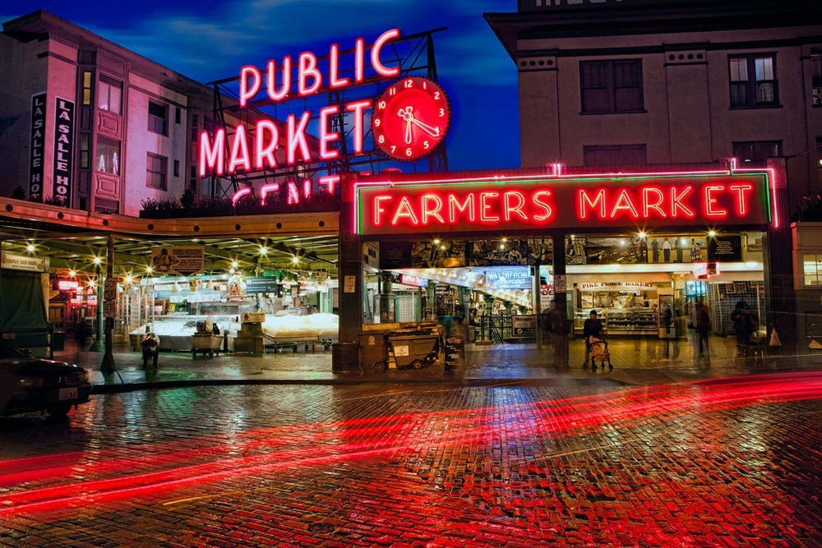
Market
Any system or place where parties are engaged in exchange of either goods or services is called as market. The parties are often called as buyers and sellers. The seller offers his goods or services to the buyer who in return purchases it in exchange of money.

Slide 3
Goods
Tangible (things which can be seen and touched) physical products which are transferred from a seller to the buyer (consumer) to fulfil the latter’s need are called as goods.
Example: Jack owned two laptops which he sold to Mike. In this case Jack is the seller while Mike is the buyer. Laptops are the goods which were earlier in Jack’s custody and now belong to Mike.

Slide 4
INTRODUCTION
What is Retail ?
Retail involves the sale of goods from a single point (malls, markets, department stores etc) directly to the consumer in small quantities for his end use.
In a layman’s language, retailing is nothing but transaction of goods between the seller and the end user as a single unit (piece) or in small quantities to satisfy the needs of the individual and for his direct consumption.

Slide 5
Supply Chain
What is supply chain?
Manufacturers → Retailers → End User(Consumers)
A supply chain is a process that occurs between companies and suppliers in order to distribute products to end users.
Basic model of a supply chain:
1. Manufacturers and Wholesalers
2. Retailer (also known as the merchant)
3. Consumer (end user)

Slide 6
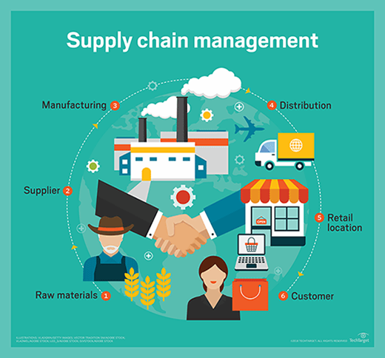

Slide 7
Manufacturers and Wholesalers
Manufacturers produce goods from raw materials using machines and labor.
Once production is complete, wholesalers purchase the goods and sell them to retailers.
Wholesalers sell large quantities of goods to retailers at low prices.

Slide 8
Retailer
Retailers purchase goods either from the wholesaler or directly from the manufacturer.
From there they will sell those goods in small quantities to end users.
Consumer
Purchases goods from the retailer in small quantities to satisfy demand.

Slide 9
Internal factors of Retail Pricing
Internal factors that influence retail prices include the following −
Manufacturing Cost − The retail company considers both, fixed and variable costs of manufacturing the product. The fixed costs does not vary depending upon the production volume. For example, property tax. The variable costs include varying costs of raw material and costs depending upon volume of production. For example, labor.
The Predetermined Objectives − The objective of the retail company varies with time and market situations. If the objective is to increase return on investment, then the company may charge a higher price. If the objective is to increase market share, then it may charge a lower price.

Slide 10
Image of the Firm − The retail company may consider its own image in the market. For example, companies with large goodwill such as Procter & Gamble can demand a higher price for their products.
Product Status − The stage at which the product is in its product life cycle determines its price. At the time of introducing the product in the market, the company may charge lower price for it to attract new customers. When the product is accepted and established in the market, the company increases the price.
Promotional Activity − If the company is spending high cost on advertising and sales promotion, then it keeps product price high in order to recover the cost of investments.

Slide 11
External Factors
External prices that influence retail prices include the following −
Competition − In case of high competition, the prices may be set low to face the competition effectively, and if there is less competition, the prices may be kept high.
Buying Power of Consumers − The sensitivity of the customer towards price variation and purchasing power of the customer contribute to setting price.

Slide 12
Market Conditions − If market is under recession, the consumers buying pattern changes. To modify their buying behavior, the product prices are set less.
Levels of Channels Involved − The retailer has to consider number of channels involved from manufacturing to retail and their expectations. The deeper the level of channels, the higher would be the product prices.
Government Policies − Government rules and regulation about manufacturing and announcement of administered prices can increase the price of product.

Slide 13
Common retail types:
Independent Retailer: An independent retailer is someone who builds business from ground up.
Existing Retail Business: Someone inherits or buys an existing business and takes over its ownership and responsibilities.
Franchise: A franchise is an existing business plan, including a trademarked name, an already determined set of products, and established business concepts.

Slide 14
Dealership: A retailer that works with a dealership has the license to sell a brand of products. Unlike a franchise, there are no fees to the licensor.
Network Marketing: Network marketing, also known as multi-level marketing, is a business model which involves a pyramid structured network of people who sell a company’s products.

Slide 15
Different types of Retail outlets:
Department Stores – the oldest, and often largest, place for consumers to shop for a variety of products under one roof. Target and Macy’s are examples.
Big Box Store – major retailers that specialize in one type of product, such as electronics. Best Buy and Bed Bath and Beyond are examples.
Discount Stores – department stores that stock discounted items and lower priced brands. Walmart and Kmart are examples.

Slide 16
Warehouse Stores – these no frills warehouses often require you to be a member to access their low prices. BJs and Costco are examples.
Mom-and-Pop Stores – smaller, often niche stores run by small business owners. These are your corner stores and local storefronts.
E-tailers – online retailers that sell via the internet and have products delivered to your door. They typically do not have physical stores. Amazon and etsy are examples.

Slide 17
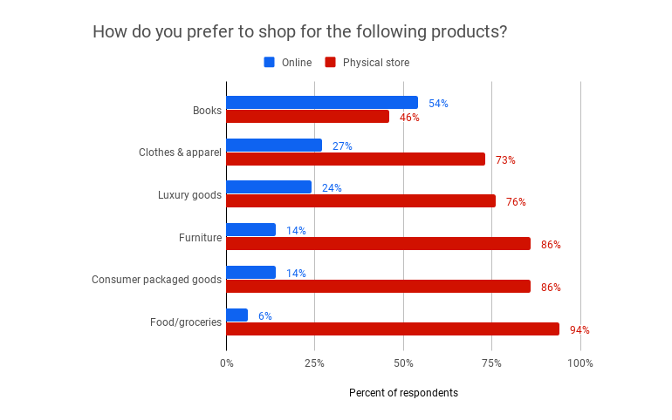

Slide 18
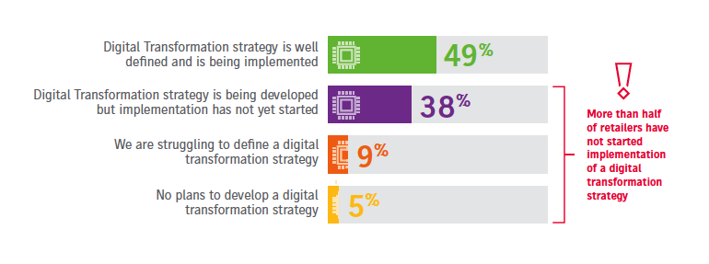

Slide 19

PROBLEMS FACED BY RETAIL INDUSTRY

Slide 20
Investment
Investment is another parameter where it’s important but challenging for principal companies to see eye-to-eye with retailers.
For instance, a furniture manufacturer might want to stock 20 units of a specific item with each retailer. But the retailers might not be keen, because this involves investment of space and inventory liability for them. At such times, the principal company must choose whether he wants presence in the geographic area (at the expense of quantity), or sales.
Taking this decision is a big challenge for principal companies. It’s difficult for them to predict how lucrative or expendable a location will be in the long run.

Slide 21
Choosing the Right Mix
Retailers want to stock multiple brands to ensure their outlets stay functional and profitable. But a challenge for them is to choose the right mix of brands to partner with. They might partner with a brand whose goods do not move off the shelf quickly.
That leads to many cascading effects, one of which is inventory management.

Slide 22
Inventory management
Inventory management is a component of supply chain management that involves supervising non-capitalized assets, or inventory, and stock items. Specifically, “inventory management supervises the flow of goods from manufacturers to warehouses and from these facilities to point of sale.
It’s not difficult to guess the inventory needed for popular goods. But for no-so-popular goods, inventory management is challenging but essential.
The more time goods spend on shelves and in warehouses, the more the revenue of retailers is impacted.

Slide 23
Visual Display
Merchandize display is the make-or-break for any retail store. Steve Jobs spent agonizingly long working on every element of Apple retail stores for years. The results are for us to see.
For instance, if a lesser known brand gets visual preference over a more popular one, the latter could reduce its business arrangement with the retailer. This could lead to revenue losses for the retailer.

Slide 24
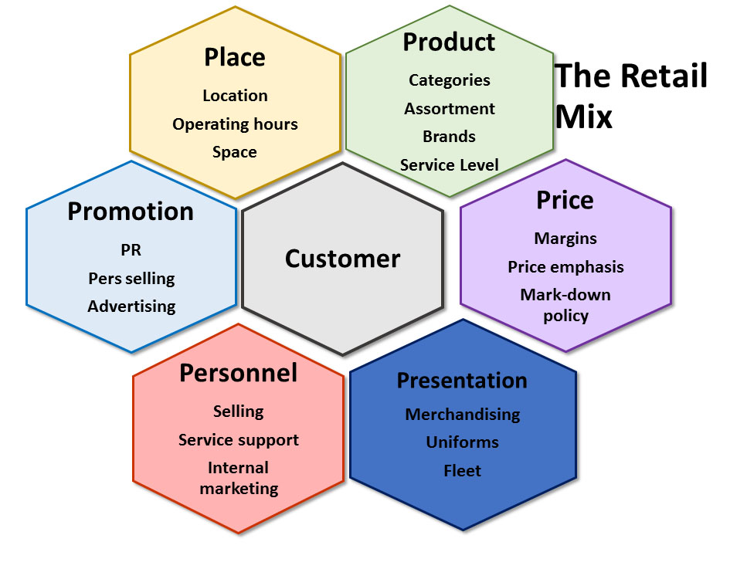

Slide 25
Customer Experience Management (CEM)
Gartner defines customer experience management (CEM) as “the practice of designing and reacting to customer interactions to meet or exceed customer expectations and, thus, increase customer satisfaction, loyalty and advocacy.” It is a strategy that requires process change and many technologies to accomplish.

Slide 26
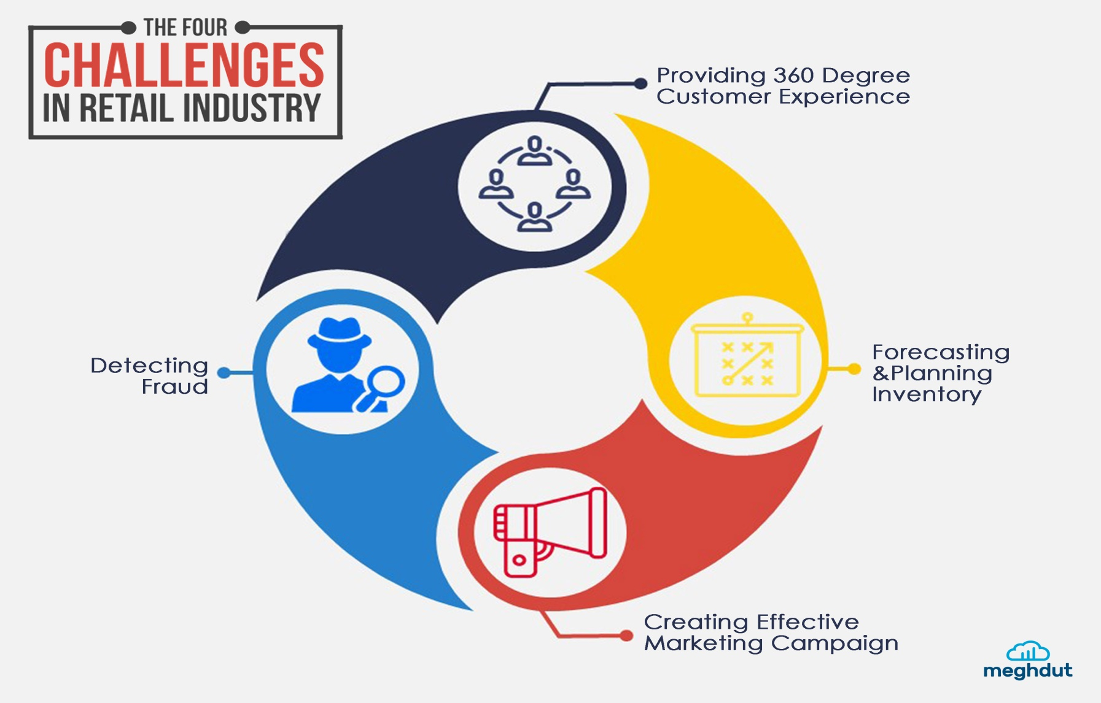
Challenges in retail industry

Slide 27
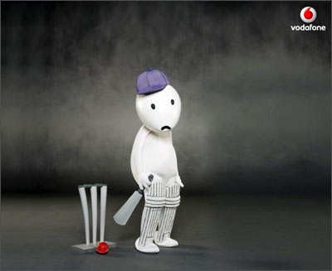
WHAT HAPPENS WHEN YOU DON’T USE ANALYTICS?
The below example show why data Analytics and Data’s are important for a company to be successful or fight over other competing companies.

Slide 28
TOYS R US
One of the most recent is the liquidation of the longstanding toy brand, Toys R Us. Not long ago, the children’s retailer announced that it would close around 180 stores in the USA alone as it begins bankruptcy proceedings.
Among a range of issues that led to its commercial doom, an obvious failure to undergo a comprehensive data-led digital transformation contributed to the brand’s downfall. By failing to use the wealth of available digital data to its advantage, Toys R Us failed to offer the kind of innovative omni-channel experience that helped set it apart from online retail giants like Amazon.
Had the company delved deeper into big data, it would have stood a tangible chance of retaining its established customer base and created a tailored shopping experience that would have helped it thrive in the digital age.

Slide 29
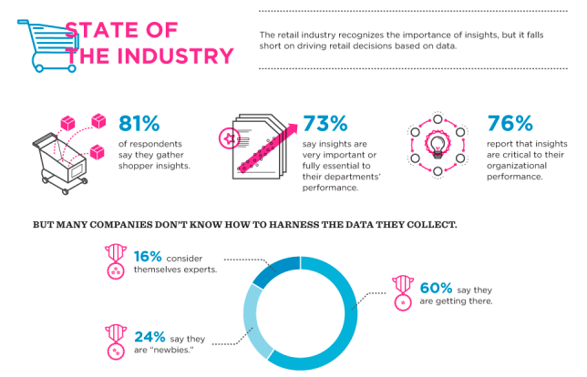

Slide 30
What is Retail Analytics?
Retail analytics focuses on providing insights related to sales, inventory, customers, and other important aspects crucial for merchants’ decision-making process.
Retail Analytics is used to help make better choices, run businesses more efficiently, and deliver improved customer service analytics.

Slide 31
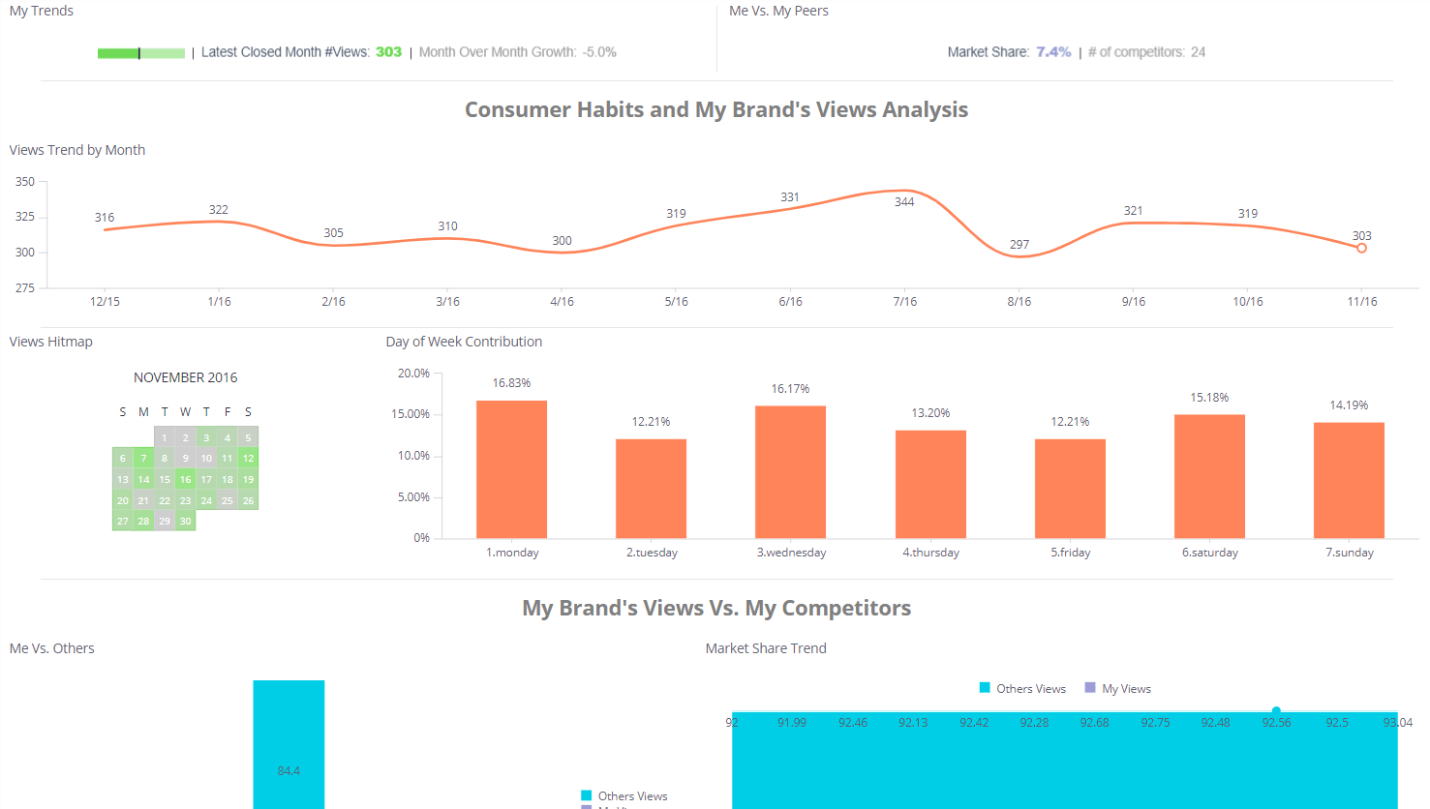
Companies use these analytics to create better snapshots of their target demographics.
By harnessing sales data analysis, retailers can identify their ideal customers according to diverse categories such as age, preferences, buying patterns, location, and more.

Slide 32

WHY ANALYTICS IN RETAIL

Slide 33
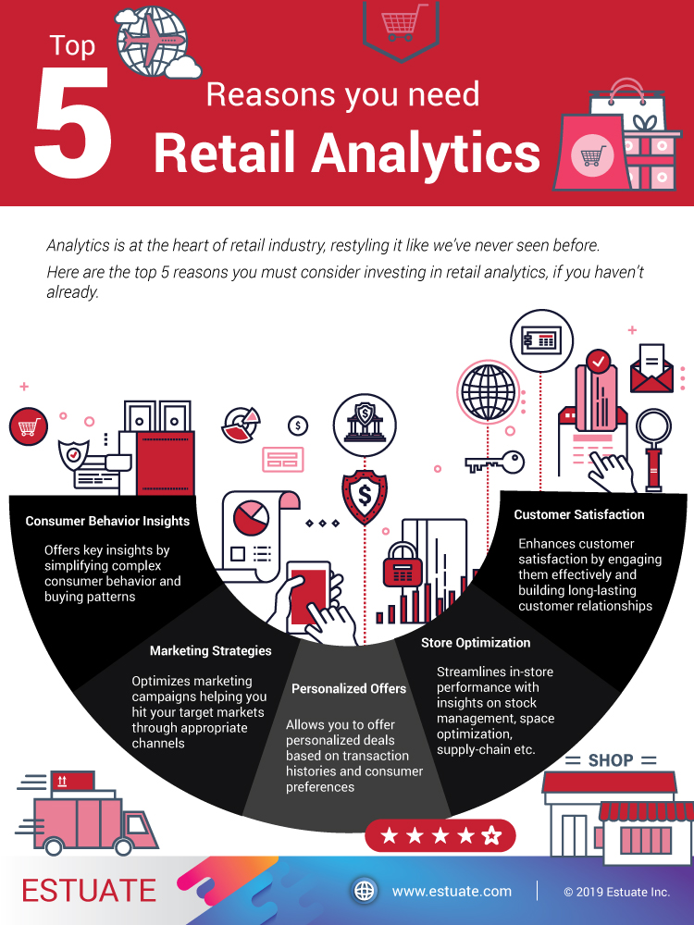

Slide 34
Consumer Behavior Insights:
Analytics allows retailers to study consumer behavior and understand their buying patterns. This is perhaps the biggest reason why retailers are investing in big data analytics.
Consumer behavior insights enable retailers to understand why these things happen and offers a solution to improve sales.

Slide 35
Marketing Strategies:
Retail analytics helps marketers strategize their activities efficiently based on consumer behavior patterns and run profitable campaigns.
As much as 13% retailers have already adopted “digital first” as their preferred marketing strategy.
Analytics helps with such minute details and helps pick the right campaign for every customer group.

Slide 36
Personalized Offers:
Customers love attention, and offering personalized deals is a great way to show your customers that they are important.
75% consumers are more likely to buy from a retailer that recognizes them by name, recommends options based on past purchases.
Analytics helps businesses track down transaction histories and consumer preferences.

Slide 37
Store Optimization:
49% consumers go for in-store shopping because they prefer to touch, feel or try a product before buying.
Retail analytics can help retailers analyze minute details like how often a customer visits the stores and in which section making further sales easier.

Slide 38
Customer Satisfaction:
Customer satisfaction is the key catalyst behind retail success.
By using analytics, retailers are able to offer the customer exactly what he wants and engage him most effectively.
This in turn helps in building a positive brand image, gaining trust and developing long-lasting retail relationships.

Slide 39
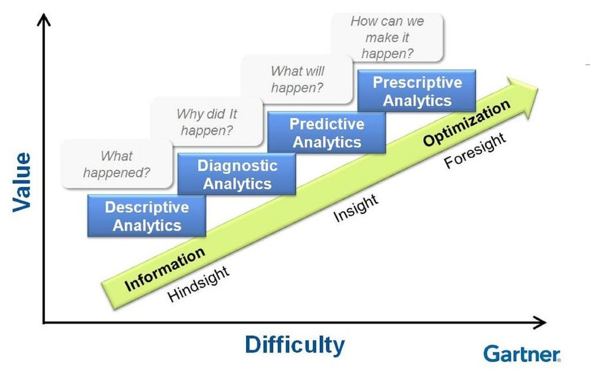
Step involved in retail analytics:

Slide 40
Descriptive analytics in retail
descriptive analytics: Insight into the past
Descriptive analytics is the interpretation of historical data to better understand changes that have occurred in a business.
Descriptive analytics are useful because they allow us to learn from past behaviors, and understand how they might influence future outcomes.
The BathTub report looks at past activity, it is very useful to see how many customers are active in your program. The appropriate action could be a drive to entice more sign-ups or to reactivate lapsed customers by giving them special offers.

Slide 41
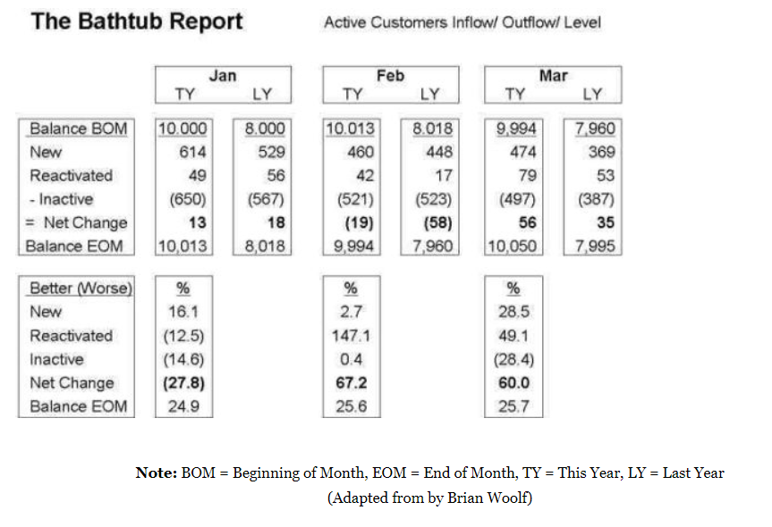

Slide 42
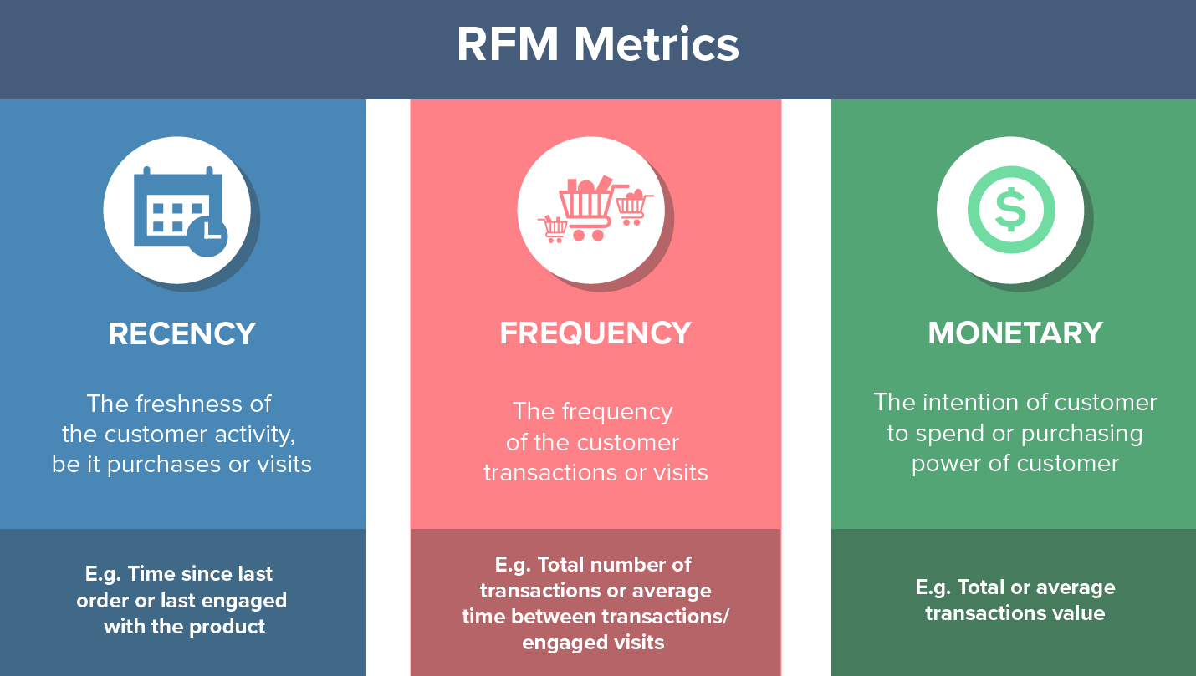
The RFM report is used to segment customers based solely on their purchasing activity. It splits the customers into 5 equal buckets (1 worst, 5 best) based on three metrics:
Recency: How long has it been since this customer has visited?
Frequency: How often has this customer visited?
Monetary Value: How much as this customer spent?

Slide 43
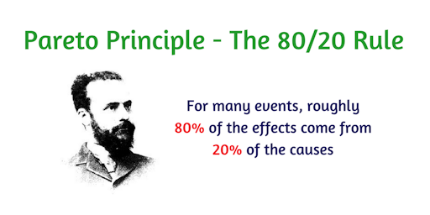
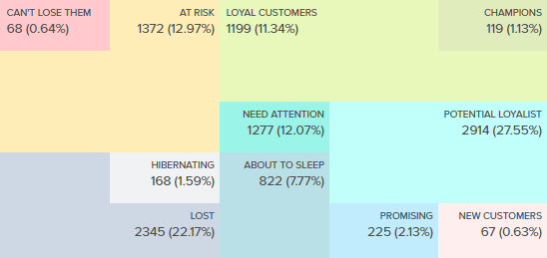
20% of customer causes to
80% of revenue
Customer segments

Slide 44
Diagnostic Analytics in retail
Diagnostic analytics is a form of advanced analytics that examines data or content to answer the question, “Why did it happen?
It is characterized by techniques such as Trend analysis, drill-down, data discovery, data mining and correlations.

Slide 45
Predictive Analysis
Predictive Analytics: Understanding the future.
Predictive analytics has its roots in the ability to “predict” what might happen. These analytics are about understanding the future.
These include member segmentation, churn analysis, custom offers and gamification.
It is important to remember that no statistical algorithm can “predict” the future with 100% certainty. Companies use these statistics to forecast what might happen in the future.

Slide 46
Prescriptive Analysis
Prescriptive Analytics: Advise on possible outcomes
The relatively new field of prescriptive analytics allows users to “prescribe” a number of different possible actions and guide them towards a solution.
In a nutshell, these analytics are all about providing advice. Prescriptive analytics attempts to quantify the effect of future decisions in order to advise on possible outcomes before the decisions are actually made.

Slide 47
WHY RETAIL ANALYTICS ARE A BUSINESS NECESSITY?

Slide 48
In the ultra-competitive retail sector, traditional sources of decision-making - such as sales history, and executives' experience and intuition - are now insufficient. Today's successful retail leaders rely on up-to-date data, metrics and solid facts to support their business decisions, including:
Customer experience decisions
Strategic decisions
Operational decisions

Slide 49
Customer experience decisions:
To make effective, customer-centric decisions, retailers and brands use retail analytics to anticipate shopper needs and provide seamless customer experience. Customer analytics in retail can also help you improve customer experience and loyalty by knowing precisely which buyers are buying which products - and personalizing your marketing based on shopper data. According to Accenture, delivering a good shopping experience improves customer satisfaction, repeat purchases, customer loyalty, customer referrals, revenues and customer engagement.

Slide 50
Strategic decisions:
Who is their target market?
What is the nature of the merchandise and services they would offer?
What are the ways in which to build a long-term advantage over competitors?

Slide 51
Operational decisions:
To improve operational performance across all channels, retail data analytics can help retailers and suppliers monitor store-level demand in real time to ensure bestselling items remain in stock. Gaining visibility into promotional performance can help you adapt your marketing, forecasting and replenishment tactics, and identify seasonal trends, popular items and opportunities to cross-sell to maximize revenue.

Slide 52
How Retailers Harness the Power of Retail Data Analytics?
Big data effectively analyzes large volumes of diverse data and helps companies gain a deeper understanding of customer demand. Applying retail data analytics through retail software solutions makes shopping more relevant, personalized and convenient, which can help you sell more and boost consumer loyalty.

Slide 53
EXAMPLE 1: KROGER
This U.S. grocery retailer has earned billions from its personalized coupon program. Kroger uses retail analytics solutions to determine which products an individual customer actually wants to buy, then sends them customized digital coupons for several of those products.

Slide 54
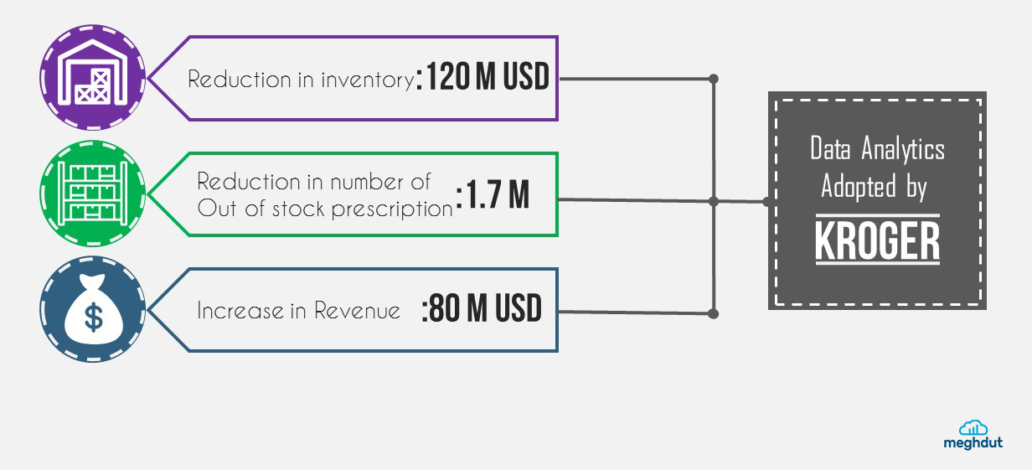

Slide 55
EXAMPLE 2: AMAZON
The e-commerce giant attracts massive online consumer traffic, which gives Amazon big data retail analytics and rich insights into the products shoppers search for and actually buy. In Q1 2016, Amazon earned $29 billion, due in large part to using big data analytics for retail decisions and knowing exactly what customers want.

Slide 56
How analytics in retail
Retail data analytics has the ability to help companies stay ahead+ of the shopping trends by applying customer analytics to uncover, interpret, and act on meaningful data insights, including online shopper and in-store patterns.
The retailers—both offline and online—are adopting the data-first strategy towards understanding the buying behavior of their customers, mapping them to products, and planning marketing strategies to sell their products to register increased profits.
Today, retailers attempt to find innovative ways to draw insights from the ever increasing amount of structured and unstructured information available about their consumer’s behavior.
Big Data analytics is now being applied at every step of the retail process - right from predicting the popular products to identifying the customers who are likely to be interested in these products and what to sell them next.

Slide 57
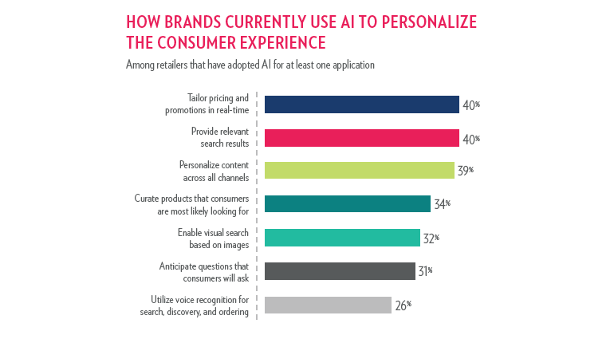

Slide 58
How it works:
Generating Recommendations: Based on a customer’s purchase history, retailers can predict what the customer is likely to purchase next. Machine learning models are trained in historical data,which allows the retailer to generate accurate recommendations.
Making strategic decisions: Companies will need to consolidate data which will help in taking informed business decisions using a single and trusted source of information about products and customers. Retail dashboards will give a high-level overview of important competitive performance metrics, including pricing promotion and catalog movements.

Slide 59
Forecasting trends: Retailers are able to understand what the market demands are using economic indicators and demographic data.
Utilizing Market Basket Analysis: A standard technique used by retailers, the market basket analysis helps figure out what products customers are most likely to purchase together. Using Hadoop, retailers can now analyze more data.
Optimizing pricing: The big retailers like Walmart are spending big on real-time merchandising systems. Walmart is currently working on a private cloud that will be able to track millions of transactions every day. Inventory levels, competitors, and demand can be tracked and market changes can be responded to automatically.

Slide 60
Listening to Social Media: Listening to what customers have to say on social media is an important activity especially for the retail industry. Platforms like Hadoop facilitate the analysis of huge amounts of unstructured data. NLP or natural language processing is used to extract information from social media sites. Machine learning is then used to make sense and give the retailer an edge over competition.
Predicting trends: Marketers are using what is called sentiment analysis. Sophisticated machine learning algorithms are used to determine context. The data gathered can then be used to predict the top selling products in a specific category.

Slide 61
Enhancing customer experience: Retail analytics will now be used to anticipate the demand of the shopper as well as produce a seamless customer experience. This will help improve the customer’s experience and loyalty.
Big Data analytics will play a major role in shaping the future of the retail industry. The big data revolution is here to stay

Slide 62
Top companies that works on Retail Analytics:
RetailNext
Euclid analytics
Modcam
Benchmark Intelligence
Kwik
Scandit

Slide 63
Benefits of Data Analysis
Ability to make faster, more informed business decisions, backed up by facts.
Deeper understanding of customer requirements which, in turn, builds better business relationships
Increased awareness of risk, enabling the implementation of preventative measures.

Slide 64
CASE STUDY

Slide 65
REAL LIFE EXAMPLES
Marconi’s Beach Outfitters: Positioning Best-Selling Products Increases Customer Loyalty.
About the company: Founded in the Cape Cod town of Wellfleet in 2007 by the Baptist family, Marconi’s Beach Outfitters sells all things beach and resort-related—from pool floats and apparel to milkshakes and fudge.
The customer data it analyzes: By looking at its customer’s demographic and price points , Marconi’s Beach Outfitters discovered a few key insights.
First, it identified its core customer base as young families with children. Next, it looked into the average spend to gauge what customers were comfortable spending.

Slide 66
What they discovered: From its POS system, Baptist was also able to see what its best-selling products were. Its homemade fudge emerged as one of the store’s top grossing products.
The results it achieved: Armed with insight into its top-selling products, Marconi’s Beach Outfitters launched an email and social media campaign focused on one of its top-selling fudges, the “Unicorn Fudge.”
On top of that, it also created an in-store concept called “Wellfleet Fudge Factor” alongside another marketing campaign targeted at the community of locals and tourists in Wellfleet, Cape Cod.
Since the launch of the marketing campaign, Marconi’s Beach Outfitters has seen a 20 percent increase in sales.

Slide 67
Zookies Cookies
About the company: Zookies Cookies sells flavored mixes for dog cookies, ranging from Peanut Barker and Pupkin Pie to Cocomutt and Begnog. Its mixes are available both online and in store.
They use Shopify and Google Analytics to get a better understanding of its dog-loving customer base. The company analyzes basic demographic information such as:
Who its customer base is
Customer’s past purchase activity
Geographical information
The number of returning customers
How many times a potential customer visits its online store before making a purchase

Slide 68
“One thing in particular that’s been helpful for our growth is learning how many folks purchase as gifts, instead of for their own pets. That’s really helped us shape our retail strategy as well,” adds Tom Simon, its chief marketing officer.
The results it achieved: Using Shopify, Zookies Cookies was able to learn more about the flavors its customers were interested in. “That was a big help for us in early production to make sure we weren’t overdoing it on flavors that tended to move a little slower,” says Simon.

Slide 69
Starbucks
Starbucks has the uncanny ability to open a number of branches on the same block and enjoy a healthy level of profit from each. By using big data analytics to its advantage, Starbucks can predict the growth potential of each new store by looking at metrics such as location, traffic, area demographics and customer behaviour.

Slide 70
Moreover, Starbucks gathered insights from their 90-plus million transactions per week and used this data to deliver a personalized experience to its customers, sparking innovations including its tailored digital rewards scheme that becomes more intuitive the more data it gathers on a customers buying habits and purchase history.
With reported revenue of $22.39 billion last year alone, it’s fair to say that Starbucks is a real retail winner.

Slide 71
Black Friday
Black Friday is on the day after Thanksgiving, which means that it will be on November 29. Based on previous Black Fridays, most Black Friday sales will start on Thanksgiving (or even before) and extend later throughout the Black Friday weekend and into Cyber Monday 2019.
Black Friday is a marketing strategy created because retailers found an increase in sales during thanksgiving.

Slide 72
Without a doubt, Black Friday and Cyber Monday are the most stressful days for retail businesses, and the most exciting days for consumers. In fact, the National Retail Federation estimates that sales in November and December are responsible for as much as 30% of retail annual sales.

Slide 73
GROUPON
Groupon is an e-commerce site that connects subscribers to discounts on activities, travel, and other goods and services. To serve that range of customers, Groupon must process over one terabyte of raw data every day.
Argos is United Kingdom’s one of the leading retailer for toys, home furnishing and personal care offering more than 43,000 products. In 2013, the company wanted to embrace a “digital-first” approach, so they went for a colossal project of opening 53 new digital stores across UK.

Slide 74
But a huge challenge also came up with this project. Argos wanted to know their customers reaction to this heavy change in store’s look and feel. They decided to track and monitor what customers were saying about them in social media channels. Brandwatch Analytics became their provider of social listening platform. The platform offered sentiment analysis features, it allowed Argos to understand people’s general sentiment about the change.

Slide 75
ARGOS
Argos is United Kingdom’s one of the leading retailer for toys, home furnishing and personal care offering more than 43,000 products. In 2013, the company wanted to embrace a “digital-first” approach, so they went for a colossal project of opening 53 new digital stores across UK.
But a huge challenge also came up with this project. Argos wanted to know their customers reaction to this heavy change in store’s look and feel. They decided to track and monitor what customers were saying about them in social media channels. Brandwatch Analytics became their provider of social listening platform. The platform offered sentiment analysis features, it allowed Argos to understand people’s general sentiment about the change.

Slide 76
Other significant insights that Argos received with this platform are:
Demographic and behavioral features of the individuals who commented about Argos
Difference of sentiments according to gender, region and user journey
The social monitoring data provide Argos some valuable inputs. For example, the male population welcomed the digital change more cordially than their female counterpart. Londoners were more favorable to the new concept of stores. Overall, these data continuously helping Argos to mold their operations to increase customer satisfaction level and boosting profitability.

Slide 77
TARGET
The company keeps the customer information in Guest ID that tracks extensive range of data like purchase history, card usage, survey responses, support issues, email responses, web site clicks and so on. This activity data is then further supplemented by purchasing demographic data like age, religion, education, marital status, children’s number, estimated income, job history and significant life events such as when you last moved or if you have been divorced or ever declared bankruptcy.

Slide 78
From the huge amount of customer data Target tracked, it saw a purchasing pattern of the woman who were in different phases of pregnancy. For instance, during the first 20 weeks pregnant women began purchasing calcium, magnesium and zinc supplements. In the second trimester, pregnant women began buying larger jeans and larger quantities of sanitizers. From the pattern, Target was able to identify pregnant customers even though they have not notified their pregnancy status to Target. Based on these customer information, Target started targeted product promotions to specific buyer segment. The financial result was astonishing for Target. It grew its revenue from $44 billion to $67 billion after they started utilizing this data analytics.

Slide 79
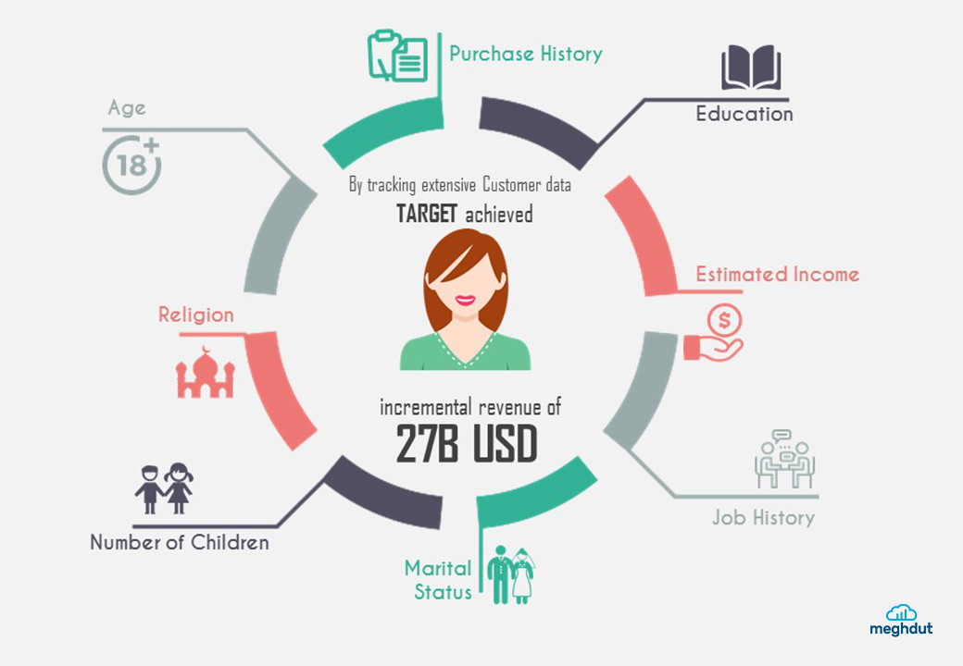

Slide 80
IKEA
IKEA is one of the reputed Home Retailers across the globe, attracting millions of footfalls in their physical and digital sphere. Their research team had this assumption that there is a strong correlation between people browsing their website and then visiting their store.
Match Media started off with pulling data from different sources to get the following metrics:
Products Added to “Shipping List”
Stock Availability Checks
Visits to local store page
Website Searches
Products Viewed

Slide 81
Using these metrics, they created an online conversion model which was used to execute a promotional campaign titled “My Kitchen”. The following outcome was observed:
a) 11% of family members who were exposed to the online ad went to IKEA to purchase kitchen items.
b) Average basket size of those who were exposed to the promotion was 45% higher than non-exposed.
c) The campaign resulted in an impressive 464% ROI.

Slide 82
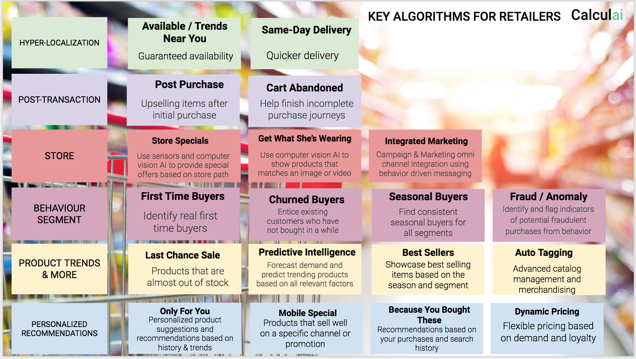
ALGORITHMS FOR RETAILERS

Slide 83
Opportunities in Retail Data Science
Retail data is increasing exponentially in volume, variety, velocity and value with every year. Smart retailers are aware that each one of these interactions holds the potential for profit.McKinsey reviews how retailers can turn insights from big data into profitable margins by developing insight-driven plans, investing in big data talent, and investing in existing employees.
This has created a need for a new brand of analyst – the data scientist. His or her job is to burrow into the mountain of big data (internal or external, structured or unstructured) to find gold. In other words, the actions retailers can take to reduce costs and increase sales.

Slide 84
Why Retailers Want to Fill More Data Scientist Positions ???
They Want to Follow the Lead of Major Competitors
Data-Related Insights Help Retailers Engage Customers
Technology Makes Data Collection More Straightforward
Data Aids Retailers in Deciding Which Enhancements to Make
Data Scientists Possess In-Demand Skills for the Retail Sector

Slide 85
DATA SETS

Slide 86
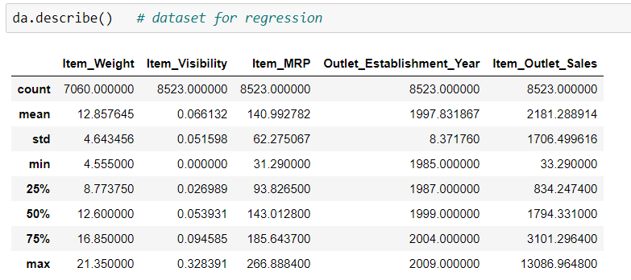
Regression Dataset
NAME : Big Mart
The data scientists at BigMart have collected 2013 sales data for 1559 products across 10 stores in different cities. Also, certain attributes of each product and store have been defined. The aim is to build a predictive model and find out the sales of each product at a particular store.
Using this model, BigMart will try to understand the properties of products and stores which play a key role in increasing sales.

Slide 87
Big Mart:
Item_Identifier: Unique product ID
Item_Weight: Weight of product
Item_Fat_Content: Whether the product is low fat or not
Item_Visibility: The % of total display area of all products in a store allocated to the particular product
Item_Type: The category to which the product belongs
Item_MRP: Maximum Retail Price (list price) of the product
Outlet_Identifier: Unique store ID
Outlet_Establishment_Year: The year in which store was established
Outlet_Size: The size of the store in terms of ground area covered
Outlet_Location_Type: The type of city in which the store is located
Outlet_Type: Whether the outlet is just a grocery store or some sort of supermarket
Item_Outlet_Sales: Sales of the product in the particulat store. This is the outcome
variable to be predicted.

Slide 88
Super Store:
Classification dataset
13. Market 14. Region 15. Product ID
16. Category 17. Sub-Category 18. Product Name 19. Sales 20. Quantity 21. Discount 22. Profit 23. Shipping Cost 24. Order Priority
1. Row ID 2. Order ID 3. Order Date 4. Ship Date 5. Ship Mode 6. Customer ID 7. Customer Name 8. Segment 9. City 10. State 11. Country 12. Postal Code

